Slide 1

PROPOSED TENANCY
OCTOBER 2021

Slide 2
Contents
Overview
Floor Distribution
Ground Floor Layout
First Floor Layout
Capacity
Tenancy Prospects
Tenancy Legal Prospects
Concessions
Revenue Projections

Slide 3
Overview
The Ilorin Innovation Hub is a state-of-the-art structure that will be the best innovation & technology structure in Nigeria and West Africa. The building will serve the following main purposes:
Create a conducive environment for people to work, interact and learn.
Provide opportunities for tenants and visitors
Provide affordable feeding options
Provide basic retail for offices
Conduct events and build a community-driven tech ecosystem
To achieve this, different sections of the Innovation Hub are being allocated to serve these needs.

Slide 4
Floor Distribution
Ground Floor | First Floor
Offices | Co-Working Spaces
Multi-purpose Hall | Offices
Conference Hall | Management Offices
Cafeteria
Snack Bar
Internal Offices
Computer Store
Server Room
Shops

Slide 5
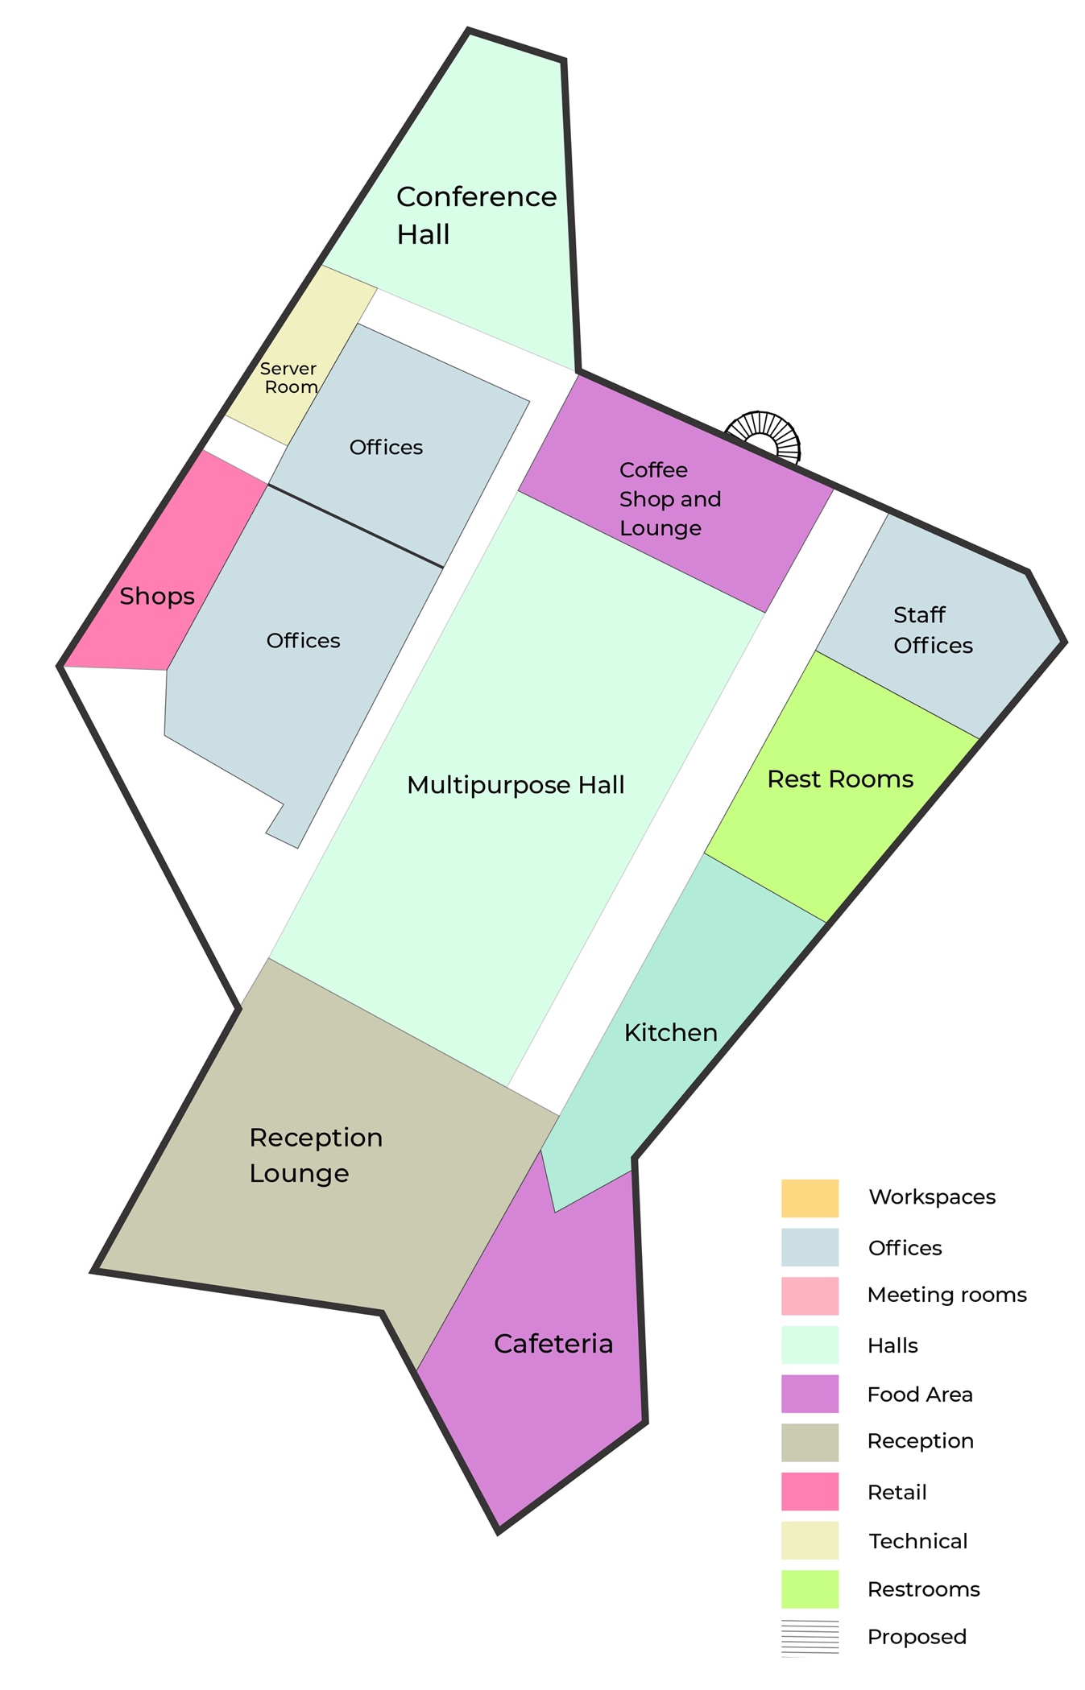
Ground Floor
Multi-purpose Hall
Conference Hall
Offices
Innovation Hub Staff Offices
Cafeteria
Kitchen
Reception
Shops
Server Room
Rest Rooms

Slide 6
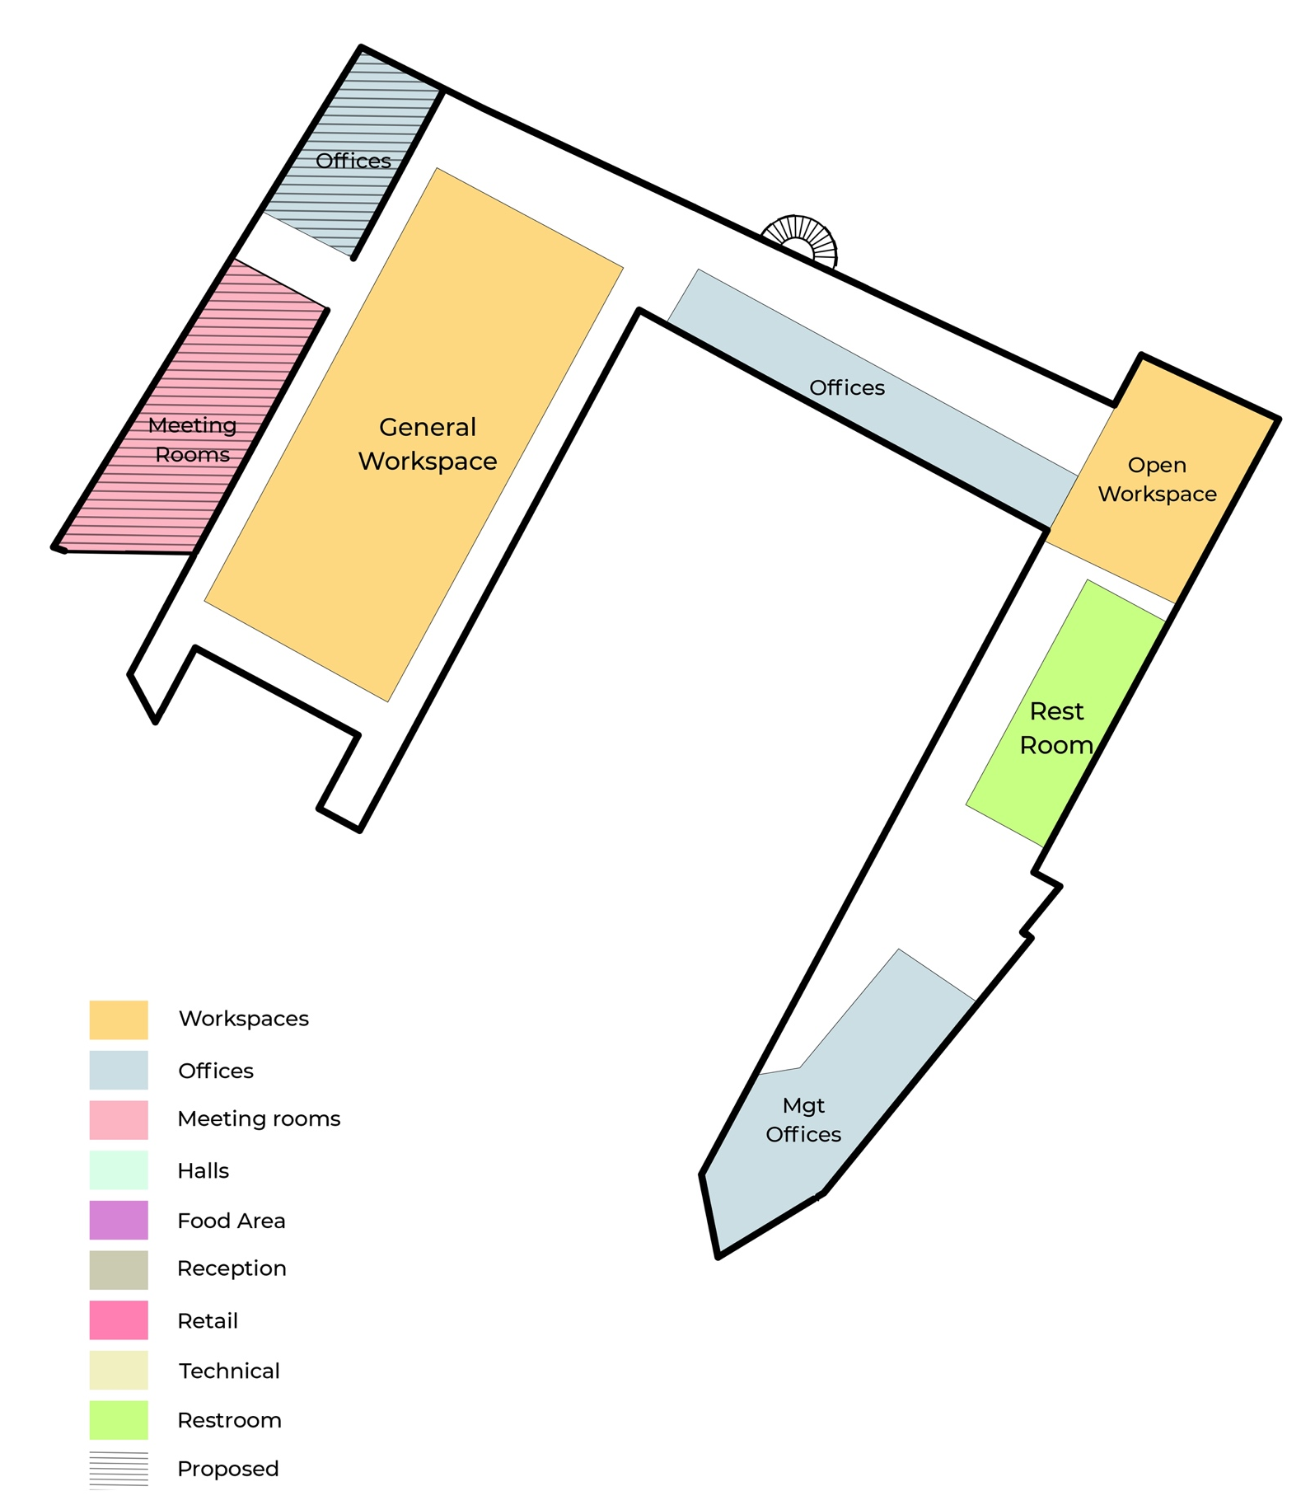
First Floor
General Workspace
Meeting Rooms (proposed)
Offices (additional proposed)
Management Offices

Slide 7
Anchor Tenant Prospects
Tenant | Proposed Location
GIZ | Ground Floor Offices
Alliance Français | Ground Floor Offices
Sterling Bank | First Floor Offices
Hugo Tech | Ground Floor Offices
US Embassy American Corner | First Floor Workspace
iLab Incubator | First Floor Offices

Slide 8
Concessions
The following sections in the Innovation Hub should be conceded out to vendors to manage, with a minimum 3-year lease arrangement.
Section | Number
Cafeteria | 1 | Continental & traditional meals
Coffee Shop | 1 | Coffee, tea, soft drinks & light snacks
Retail Shops | 3 | Computer store, bookstore.

Slide 9
Yearly Tenancy Revenue Projection
SN | Space | Rate | Number of Units | Revenue
1 | Office Plan 1 (downstairs) | 1,500,000 | 3 | 4,500,000
2 | Office Plan 2 (upstairs) | 600,000 | 5 | 3,000,000
3 | Office Plan 3 (upstairs) | 700,000 | 2 | 1,400,000
4 | Individual Workspace (upstairs) | 20,000 | 100 | 2,000,000
5 | Individual Workspace (in multipurpose hall downstairs) | 20,000 | 150 | 3,000,000
6 | Cafeteria | 6,000,000 | 1 | 6,000,000
7 | Coffee Shop | 2,000,000 | 1 | 2,000,000
8 | Retail Shops | 1,000,000 | 3 | 3,000,000
9 | Conference Hall Rentals (estimate) | 10,800,000 | 1 | 10,800,000
10 | Main Hall Rentals (estimate) | 12,400,000 | 1 | 8,400,000
 | Total |  |  | 48,100,000

